Slide 1
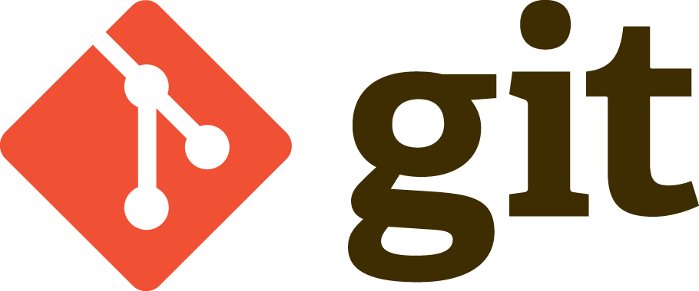
Sowmya Surampalli

Slide 2
Contents
Distributed Version Control System
Features of Git
Advantages
Disadvantages

Slide 3
Distributed Version Control System
Version control allows us to maintain all phases of development in the software.
Useful when teams or people work collaboratively on a project.
We can track the changes made in the project.
Upon an unsuccessful move in the project, older version can be reloaded.
DVCS support asynchronous collaboration from any time zone.
DVCS doesn’t require constant connection to the central repository.

Slide 4
Features of Git
Branch Work Flow:
Can branch the project to work on and can merge the new features
Distributed Development:
Supports teams to work on a project remotely and then synchronize the project.
Pull requests:
A pull request is a way to ask another developer to merge one of your branches into their repository.

Slide 5
Features of Git- Cont.
Community:
Git is usually famous for open source projects. Anyone can clone the project and make necessary improvements to it.
Faster release cycle:
Developers are encouraged to share smaller changes more frequently thus supporting agility.

Slide 6
Advantages
Distributed model
Easy branching and merging
Flexible workflow
Assured data integrity
Fast
Difference in staging and committing
Data redundancy and replication
Only one.git directory per repository
Superior disk utilization and network performance
Collaboration friendly
Any sort of projects can use GIT

Slide 7
Disadvantages
Tough to learn
Git is less preferred for handling extremely large files or frequently changing binary files .
GIT does not support ‘commits’ across multiple branches or tags.

Slide 8
Thank you

